Slide 1

The CMMC Fledge System
Project Manager: Connor McFarren

Slide 2
Topics
Background Information on CMMC
What is the CMMC Fledge System?
Progress so far
Quick Look at Website Statements
Storyboard
System Diagrams
Next Steps

Slide 3
Background
What is CMMC?
The Cybersecurity Maturity Model Certification (CMMC) is a DoD compliance framework. It utilizes the NIST 800-171 rev 2 standard.
Why is CMMC important?
Starting this year and until 2028 CMMC is being rolled out as an mandatory requirement for organizations to contract with the DoD and other parties.
DoD contracts are lucrative and critical to many businesses
How do organizations start the CMMC process?
Many organizations reach out to companies that offer pre-assessment engagements
These are expensive
Some organizations try to start process themselves
This is time consuming and very convoluted

Slide 4
What is NIST 800-171?
NIST 800-171 rev 2 is a list of 110 controls that are broken down into 14 control families (rev 3 is 17)
Access Control (AC)
Awareness and Training (AT)
Audit and Accountability (AU)
Configuration Management (CM)
Identification and Authentication (IA)
Incident Response (IR)
Maintenance (MA)
Media Protection (MP)
Personnel Security (PS)
Physical and Environmental Protection (PE)
Risk Assessment (RA)
Security Assessment (CA)
System and Communications Protection (SC)
System and Information Integrity (SI)

Slide 5
CMMC Levels
CMMC l1: Is the base level of certification. This certification only includes 15 controls from the NIST 800-171 Rev 2 standard.
CMMC L2 (Self-Assessment): Is a slight deviation from the traditional CMMC l2 Third-Party assessment. This level still contains CUI but must not contain any CUI types that are listed within the DoD CUI Registry.
CMMC l2 (C3PAO Assessment): Is the most popular choice among those seeking CMMC certification. For organizations that have any Basic CUI types. Includes all 110 controls from NIST 800-171 Rev 2.
CMMC l3: Is for the most secure types of systems. Scoped out of CMMC Fledge.

Slide 6
What is CMMC Fledge?
The CMMC Fledge System will try to fix the gap within the market
The CMMC Fledge System will allow organizations to take a quick assessment to see where they stand
At the end of the assessment the CMMC Fledge will provide next steps and show potential gaps in the organizations current system

Slide 7
Progress
CMMC research completed
Website statements partially drafted
Storyboards drafted
System diagrams drafted

Slide 8
Quick Look at Website Statements
Click Here

Slide 9
The CMMC Fledge System Storyboard

Slide 10
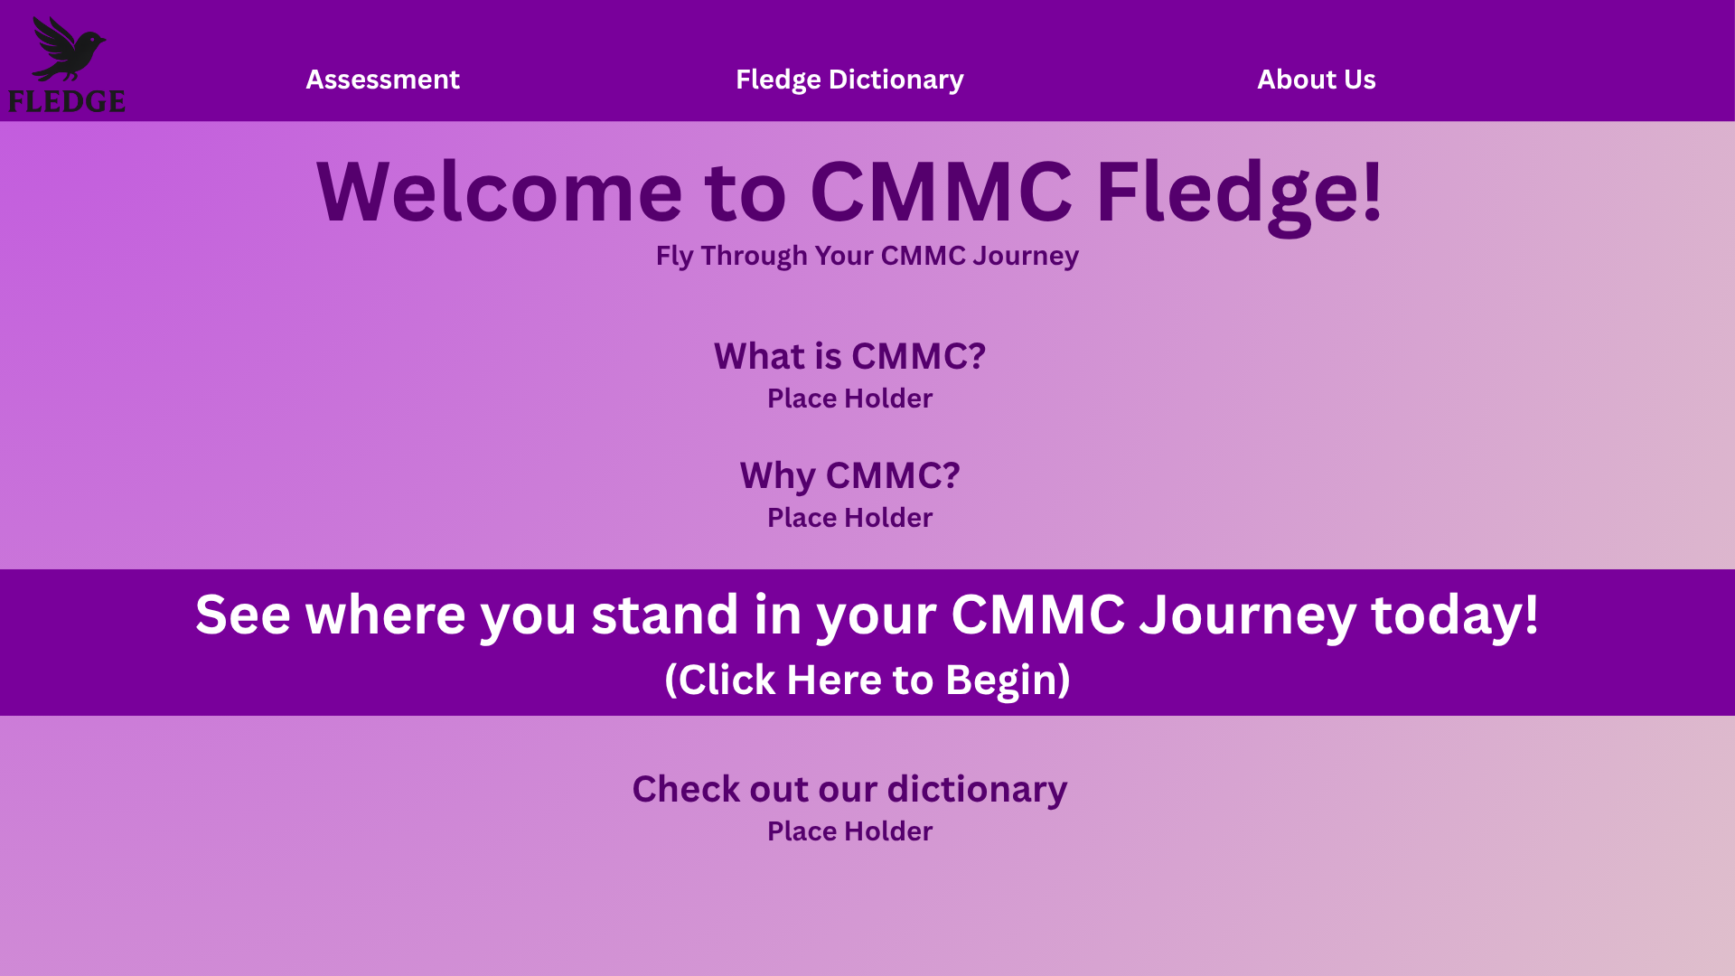

Slide 11
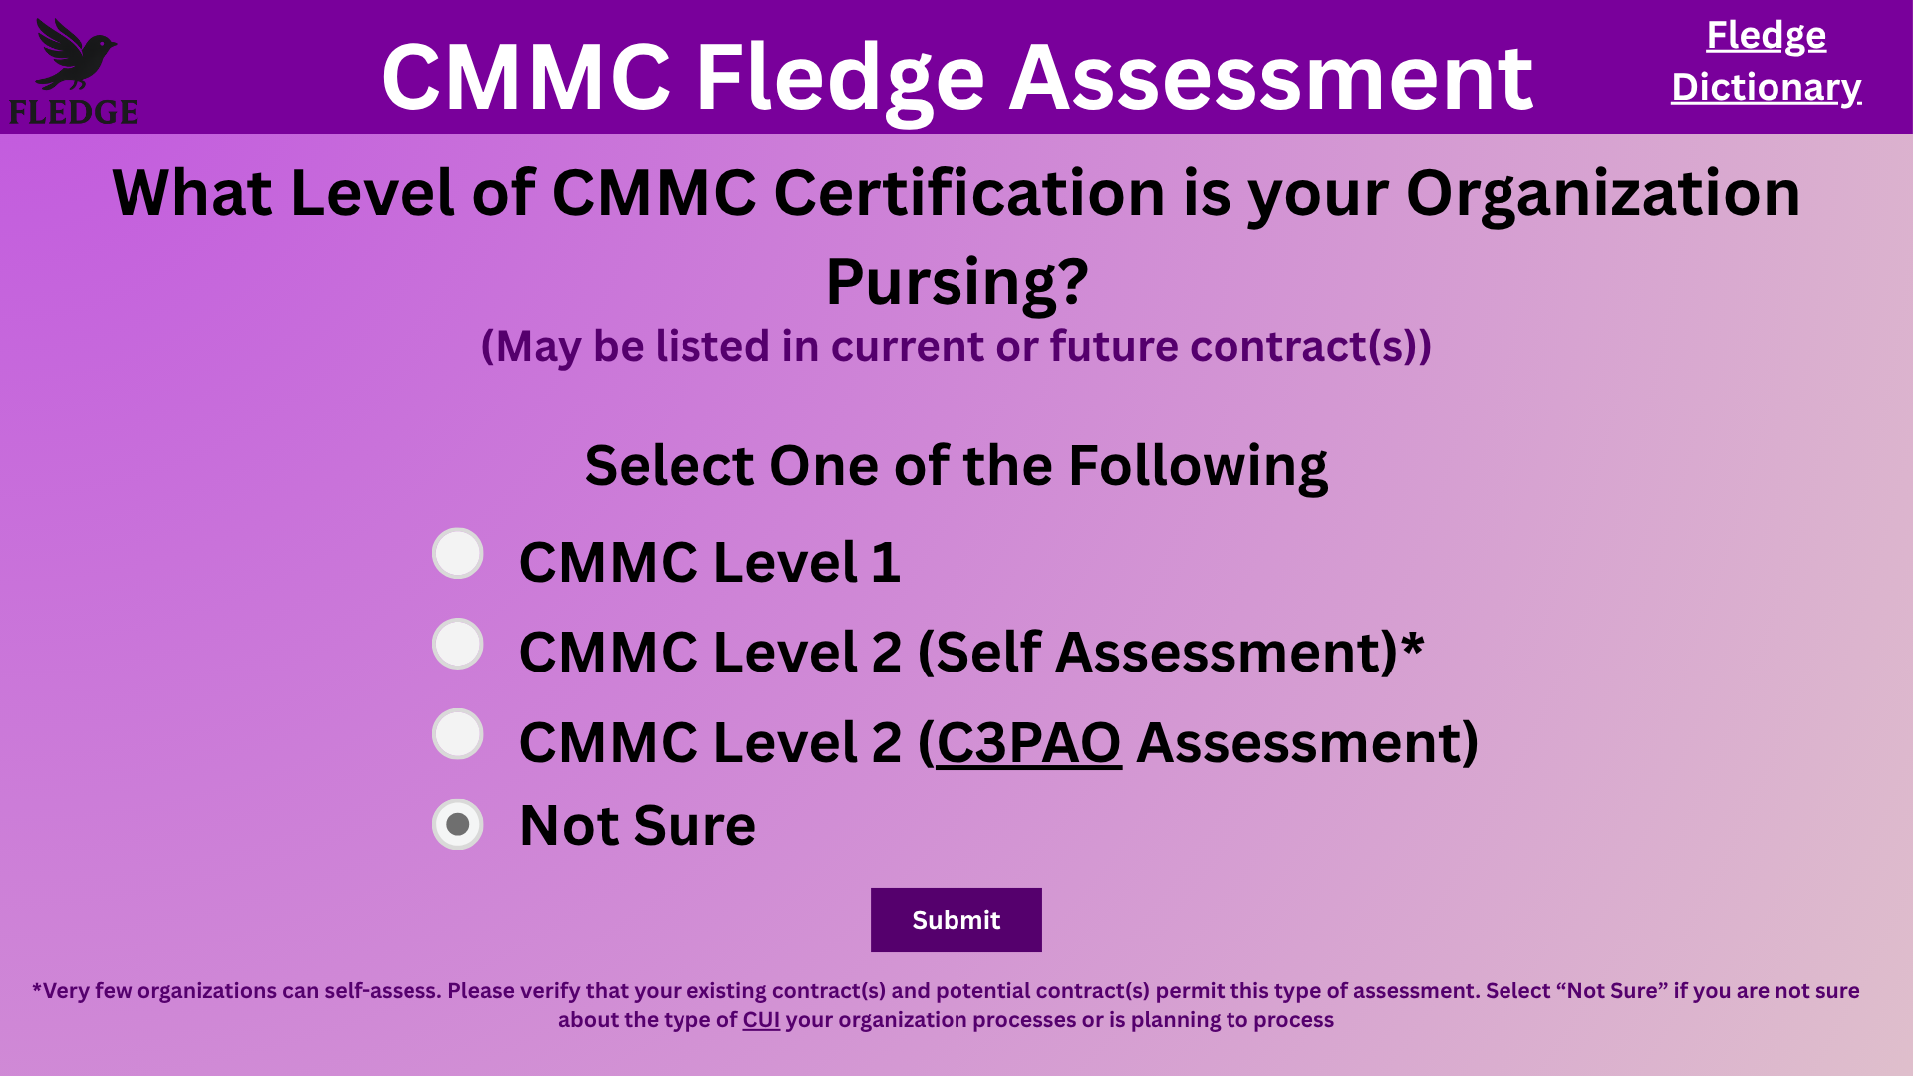

Slide 12
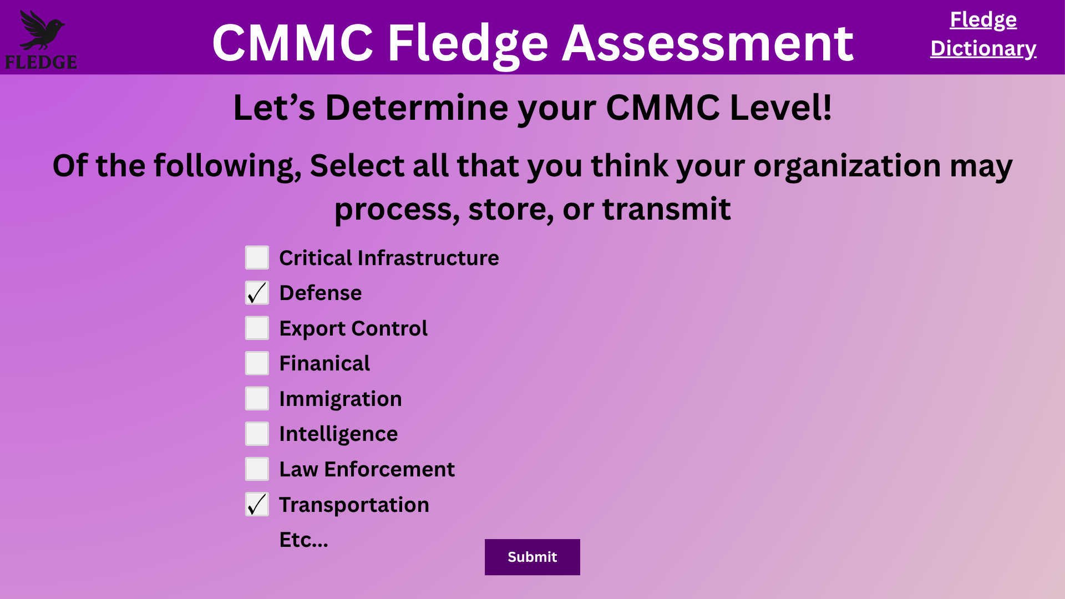

Slide 13
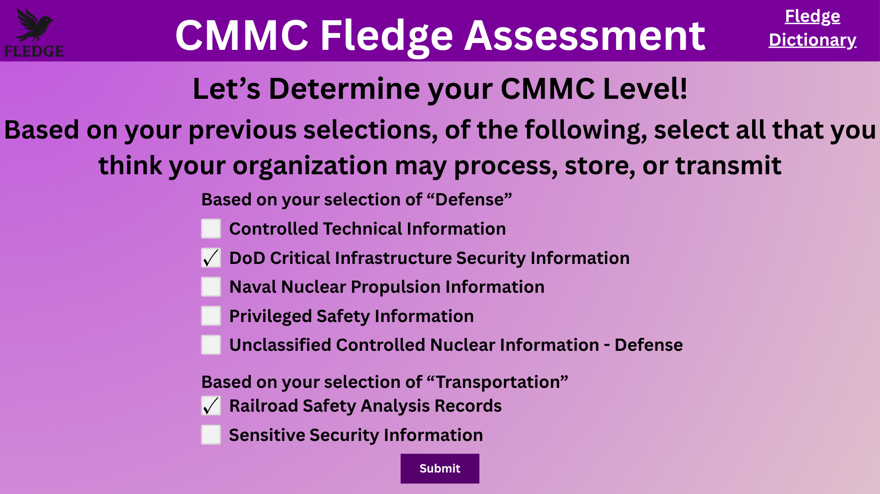

Slide 14
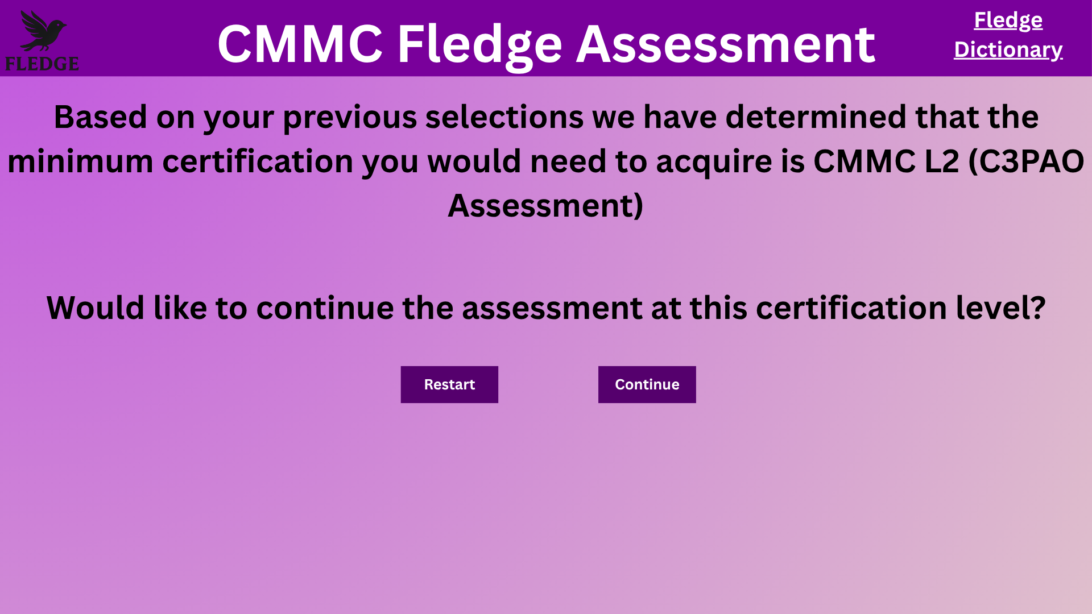
CMMC level justifications

Slide 15
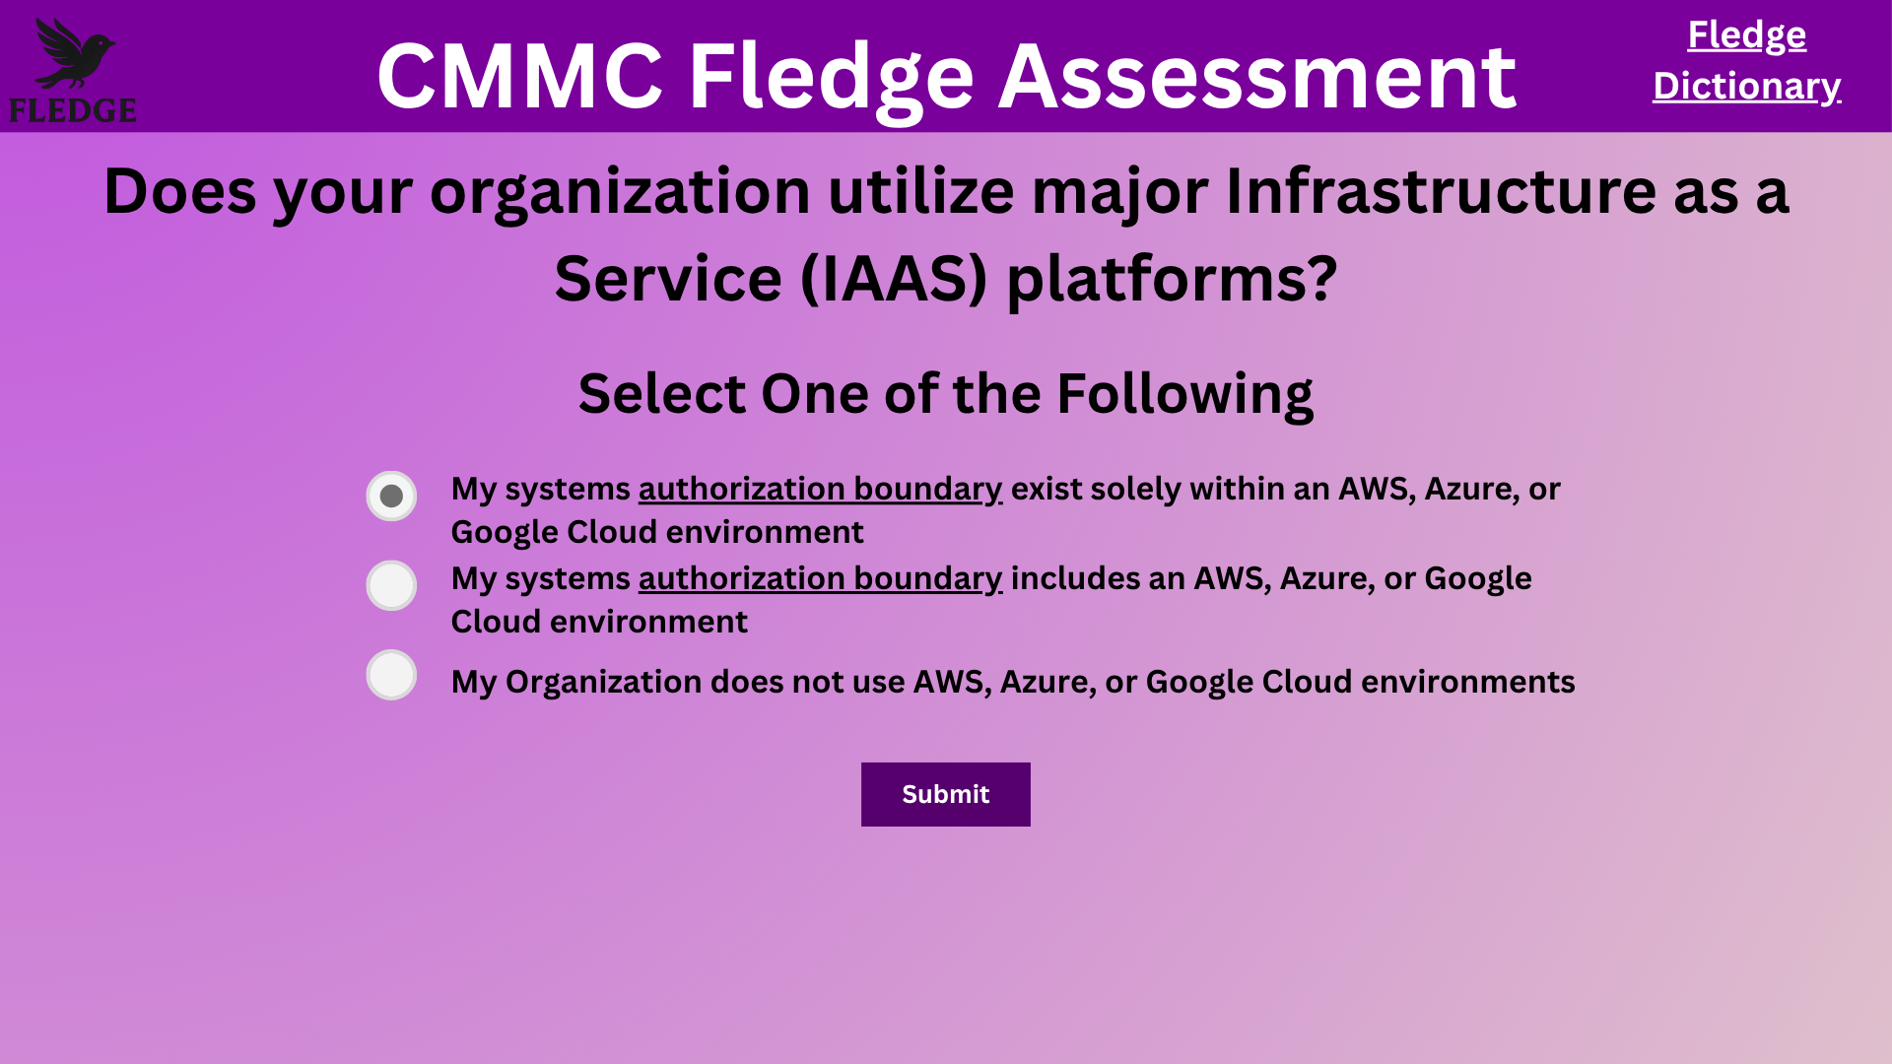
IAAS selection

Slide 16
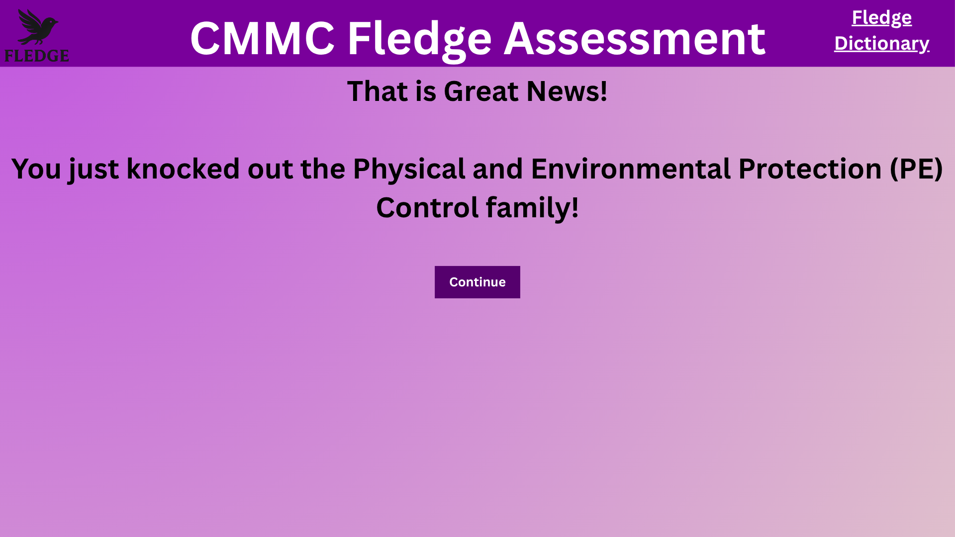
Good news they cover all of the environmental controls

Slide 17
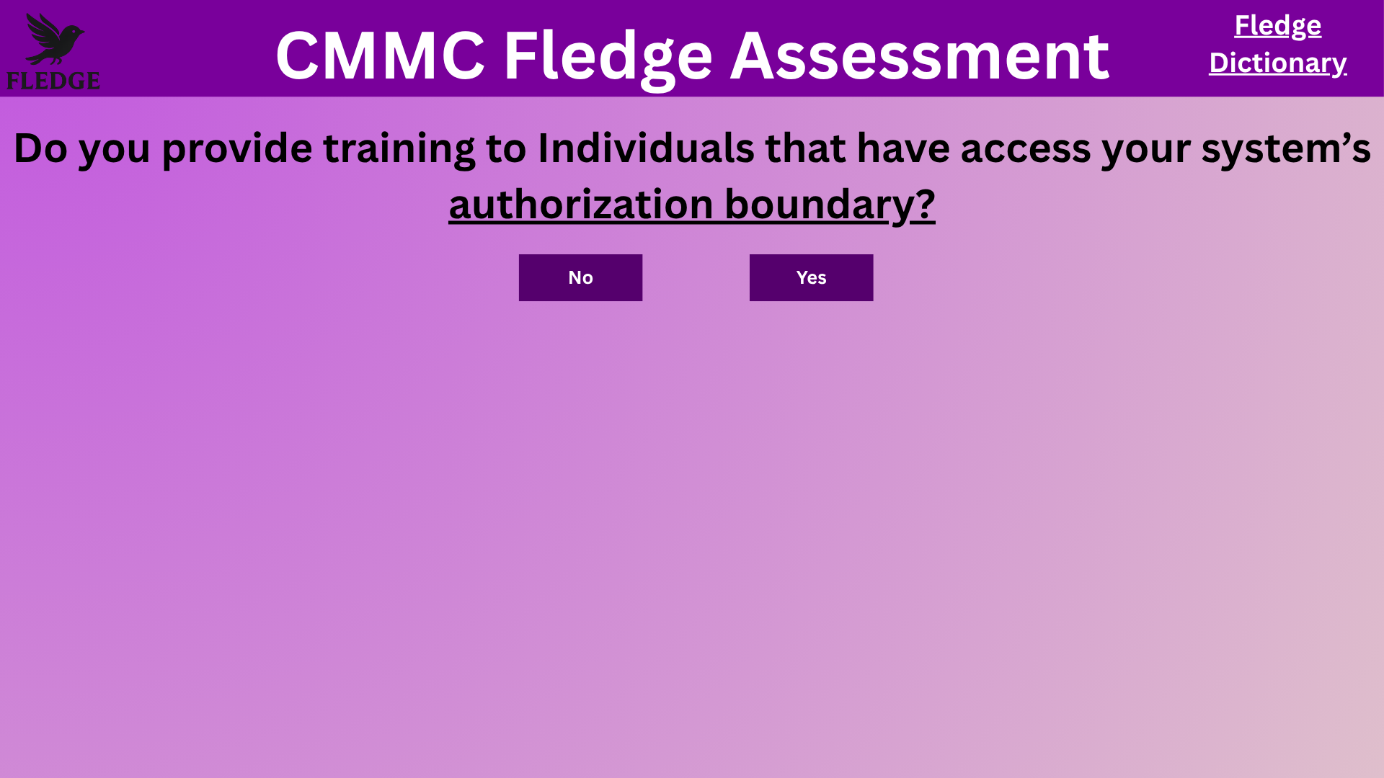

Slide 18
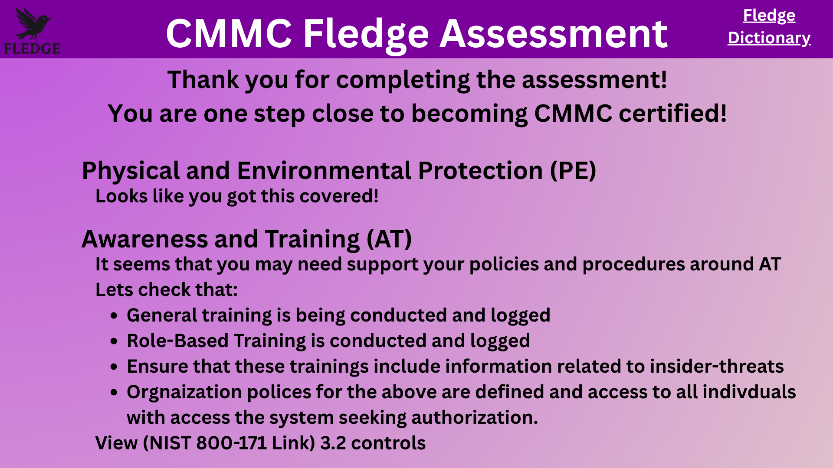

Slide 19
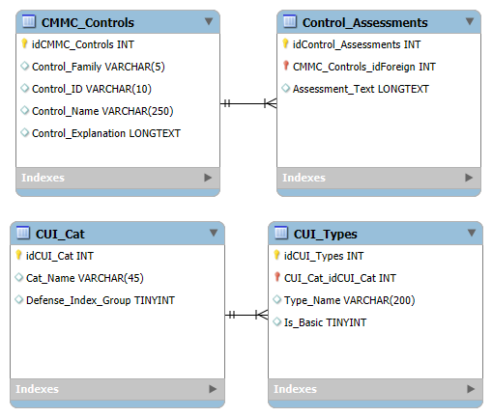
Database ERD

Slide 20
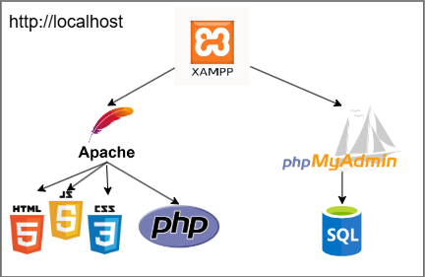
Development Technologies

Slide 21
What’s Next?
Starting the implementation (XAMPP)
Finishing all statements for all pathways
Create AWS environment

Slide 22
Questions?

